Slide 1
2022 San Francisco Mechanical Code (SFMC) Air Conditioning Unit Location Requirement
Mechanical Plan Review Section, SFDBI
August 8, 2022

Slide 2
Reasons for Outdoor Air Conditioning Unit Location Requirements
Outdoor condenser units can emit up to 82 dB, depending on the models.
With the current All-Electric requirement for new construction buildings (SFBC 106A.1.17) https://codelibrary.amlegal.com/codes/san_francisco/latest/sf_building/0-0-0-92027 , the number of buildings with split heat pump systems has greatly increased. Split heat pump systems have an outdoor condenser component.
DBI has also seen an increase in the number of existing residential buildings being provided with split heat pump systems due to heat pump systems being highly efficient, providing both heating and cooling, and having a reduced carbon footprint.
Until the recent code change, the most common space conditioning system installed in San Francisco for residential dwelling units were furnaces, which typically have no outdoor component.
The property line distance requirement, combined with the current San Francisco Police Code Article 29: Regulation of Noise, is proposed to help mitigate noise concerns from neighboring residents.

Slide 3
The proposed code language to be added to 2022 SFMC section 308.2 to address the location of the outdoor air conditioning unit.
2022 CMC Section 308:
308.0 Improper Location. 308.1 General. Piping or equipment shall not be so located as to interfere with the normal use thereof or with the normal operation and use of windows, doors, or other required facilities.
Proposed 2022 SFMC 308.2:
308.2 The outdoor Air Conditioning unit shall not be located less than 5 feet from the property line. Refer to the San Francisco Police Code Article 29: Regulation of Noise for the noise limits due to the installation of an outdoor Air Conditioning unit. https://codelibrary.amlegal.com/codes/san_francisco/latest/sf_police/0-0-0-6461

Slide 4
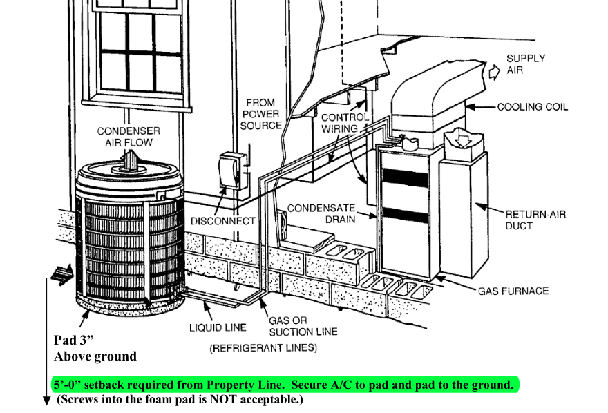
Example of Other Local Jurisdiction Requirements: City of Santa Clara

Slide 5
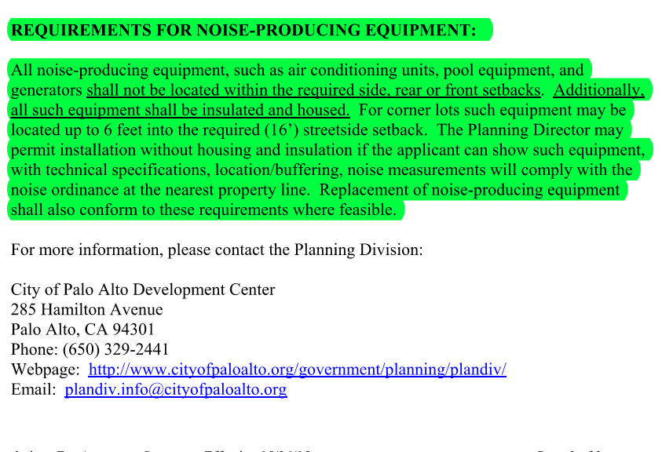
Example of Other Local Jurisdiction Requirements: City of Palo Alto

Slide 6
Example of Other Local Jurisdiction Requirements: City of Los Altos

Slide 7
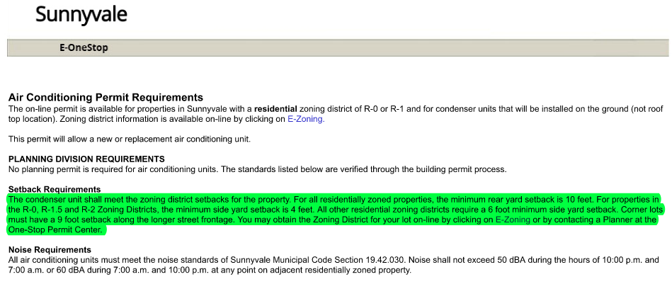
Example of Other Local Jurisdiction Requirements: City of Sunnyvale

Slide 8
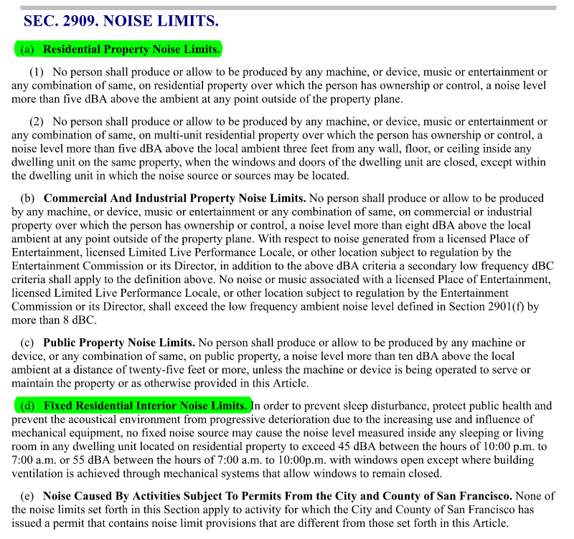
San Francisco Police Code Article 29: Regulation of Noise https://codelibrary.amlegal.com/codes/san_francisco/latest/sf_police/0-0-0-6461

